Slide 1
AldeiA
FAJÃ DAS ÉGUAS – SERRA D’ÁGUA – MADEIRA ISLAND
Sustainability, Preservation, Identity

Slide 2
AldeiA cria equilibrio entre a Natureza e o Homem, no coração da Ilha da Madeira
AldeiA will create balance between Nature
and Humans, in the heart of Madeira island

Slide 3
The brief AldeiA history
In 2015 I went on vacation to a Portuguese Island , I never heard about.
On this vacation I discovered the valley of Fajã das Éguas and a unfinished house for sale.
I bought the house, and since then, escaping the winter in Norway.
After learning basic Portuguese, I meet people working in the Natural Park preservation.
These friendships helped me starting the project AldeiA, get knowledge about this protected valley, and potential financial support from the European Union. When I later met a local neighbor, with several properties for sale, I manage to convince the bank in Norway again…
From December 2017 AldeiA, we have beenworking to find out what are the possibilities with the properties.
June 2019 PRODERAM2020 / The Madeiran Government approved the Forest project. This means that the Forest Project will receive economic support. The forest project will have the main focus this year. Also AldeiA will work to get the tourism project approved and/or working with creating a sustainable Community with the properties in AldeiA.

Slide 4
5 hours
Madeira Island
1:45 hours

Slide 5
Madeira Island by car
25 min.
AldeiA
20 min.
15 min.
20 min.
Airport

Slide 6
AldeiA total area: 45 000m2
1 House (with infrastructure)
9 Properties: from 200m2 to 38 000m2
7 Ruins
1 Mountain
Agriculture, Forest and Natural Lands

Slide 7
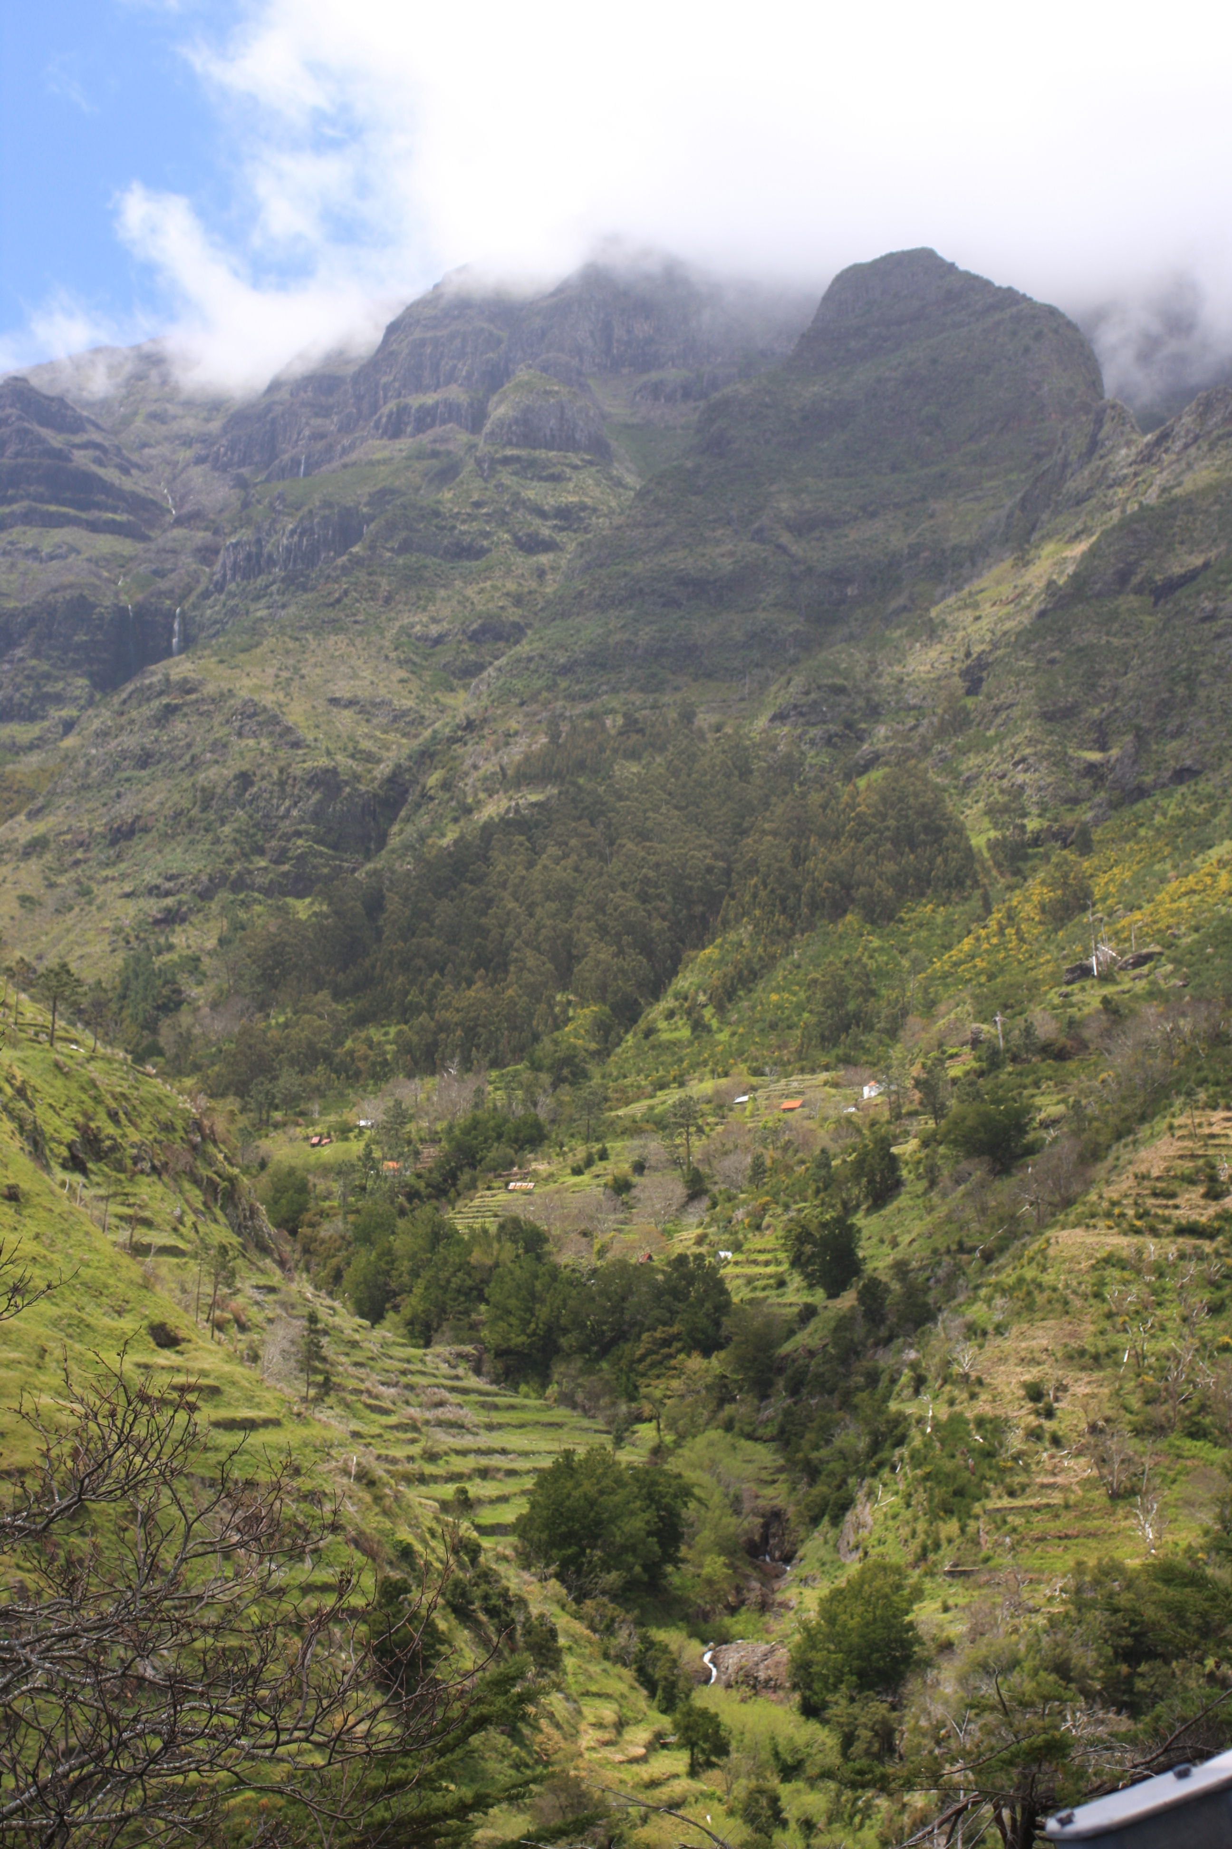
AldeiA´s VISION
Awake the lost paradise of Fajã das Éguas valley,
Into a Sustainable community who works and lives locally based on the ecosystem.

Slide 8
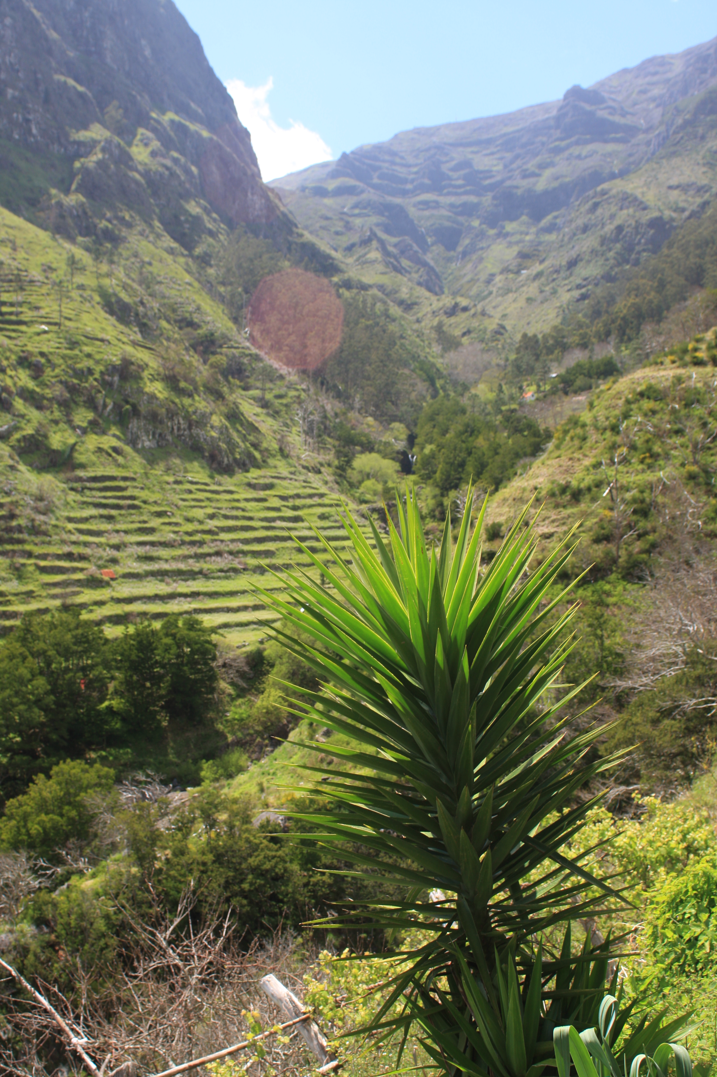
AldeiA´s MISSION
Back to ORIGINS, through life’s ESSENCE.
Reconnecting people through
Nature, inspiring, involving, sharing, teaching, caring of the environment and local people in a sustainable way.

Slide 9
3 Projects AldeiA

Slide 10
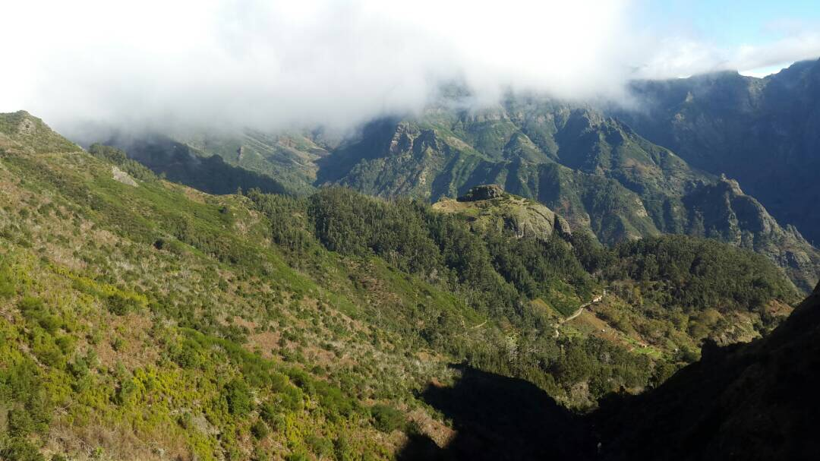
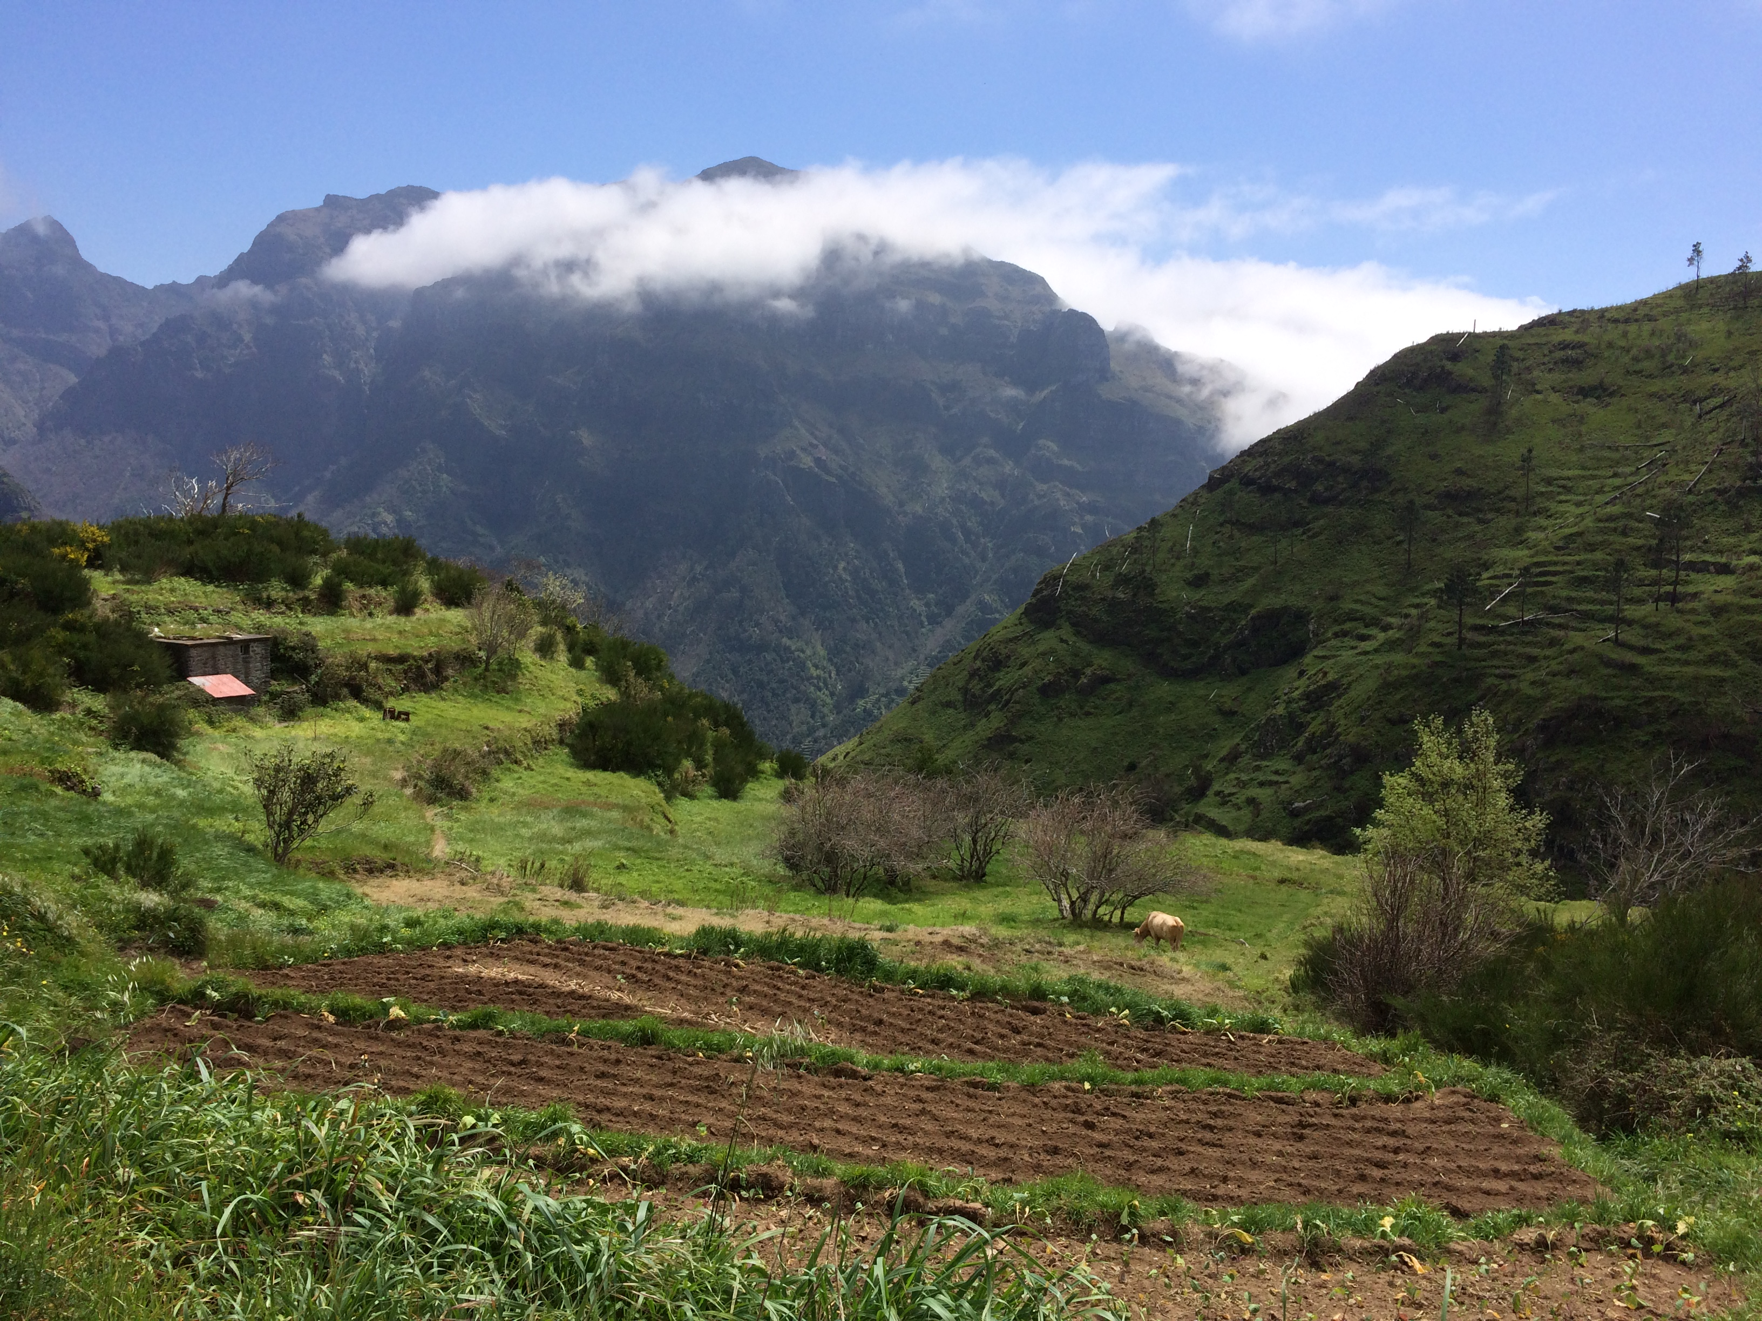
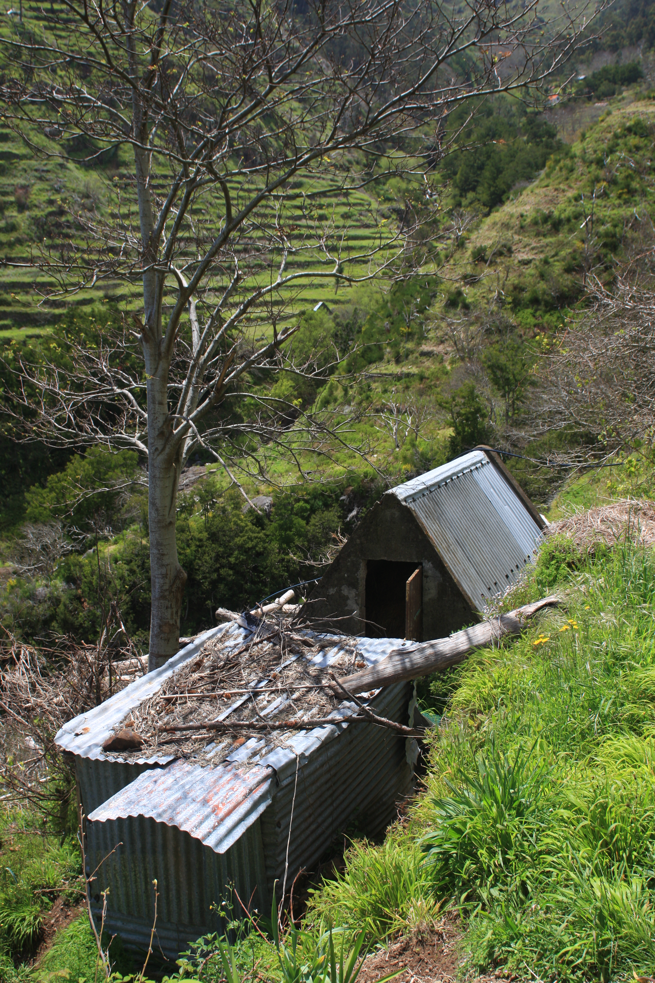
FOREST PROJECT
TOURISTIC PROJECT
AGRICULTURAL PROJECT

Slide 11
AldeiA
1. FOREST PROJECT
Reforestation / restore ecosystem
Eradicate invasive species
Prevent wild fires
“ Destination for endemics and native plants”
Footpath
Recreation area

Slide 12
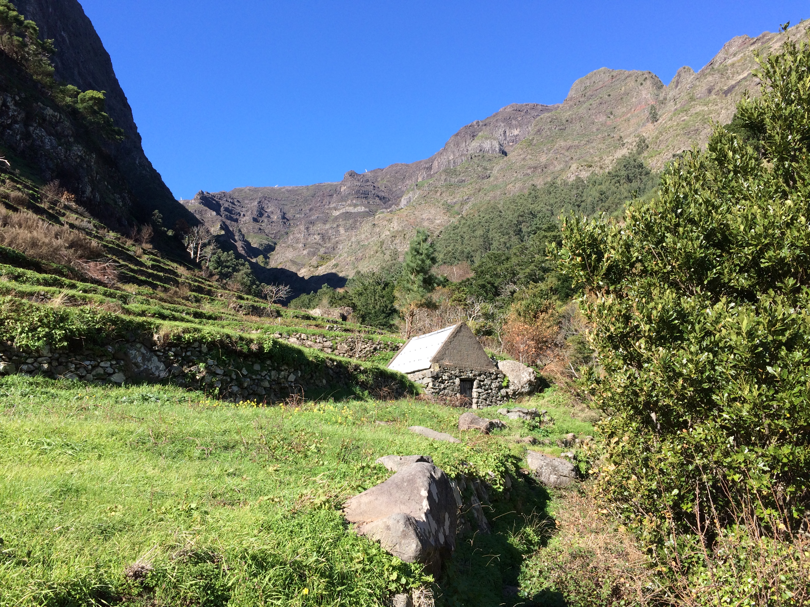
AldeiA
2. TOURISTIC PROJECT
2.1 Rebuild ruins: Village tourism ( 5 units)
2.2 The farming house:
Endemic plants nursery
Library
Workshop center
Holistic activities
Cooporation with preservation and scientific projects
Other partnerships

Slide 13
AldeiA
3. AGRiCULTURE PROJECT
Organic and biodynamic agriculture
Sustentabilility of the citizens
Homemade products
Farm market

Slide 14
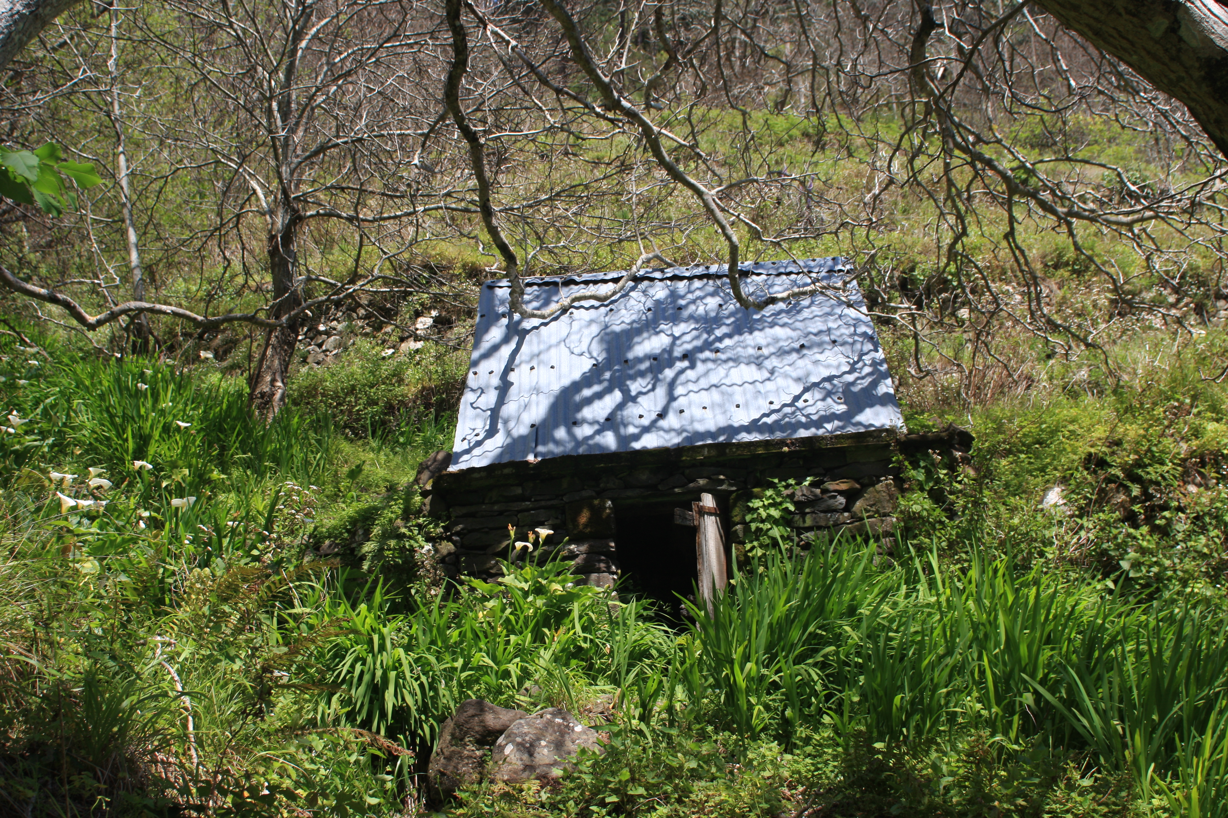
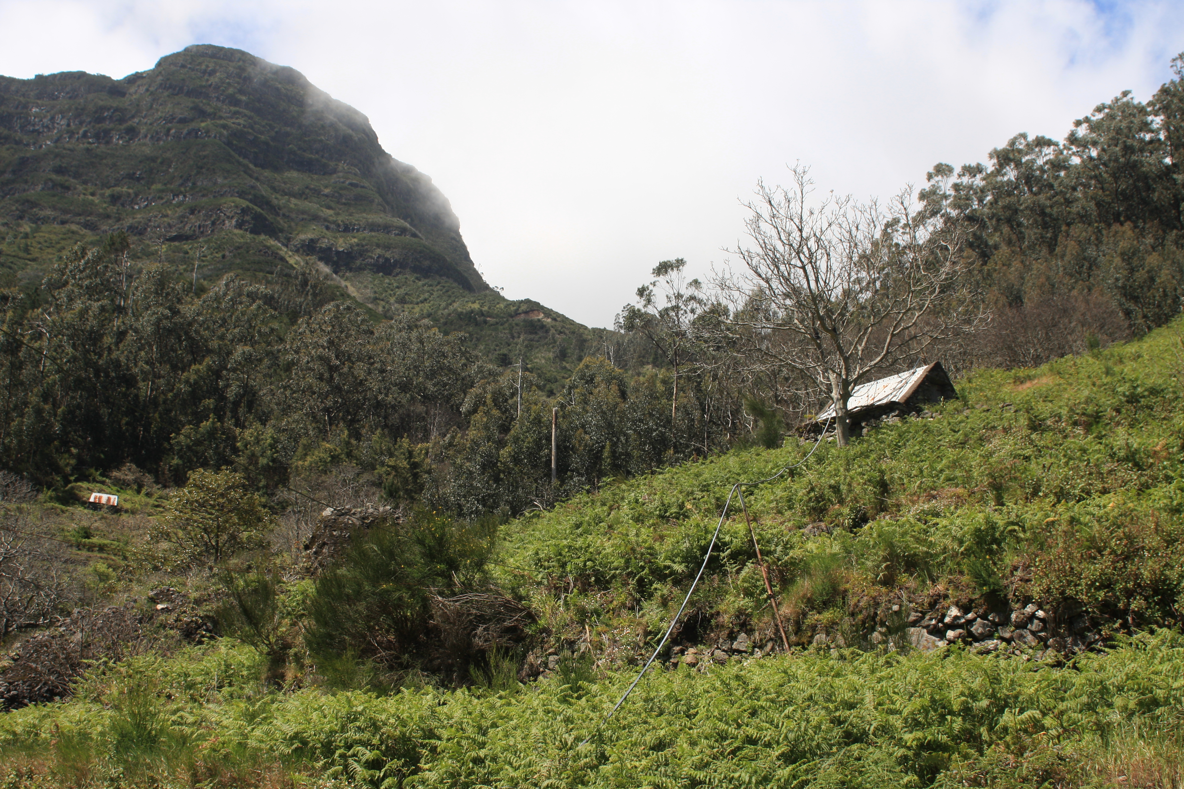
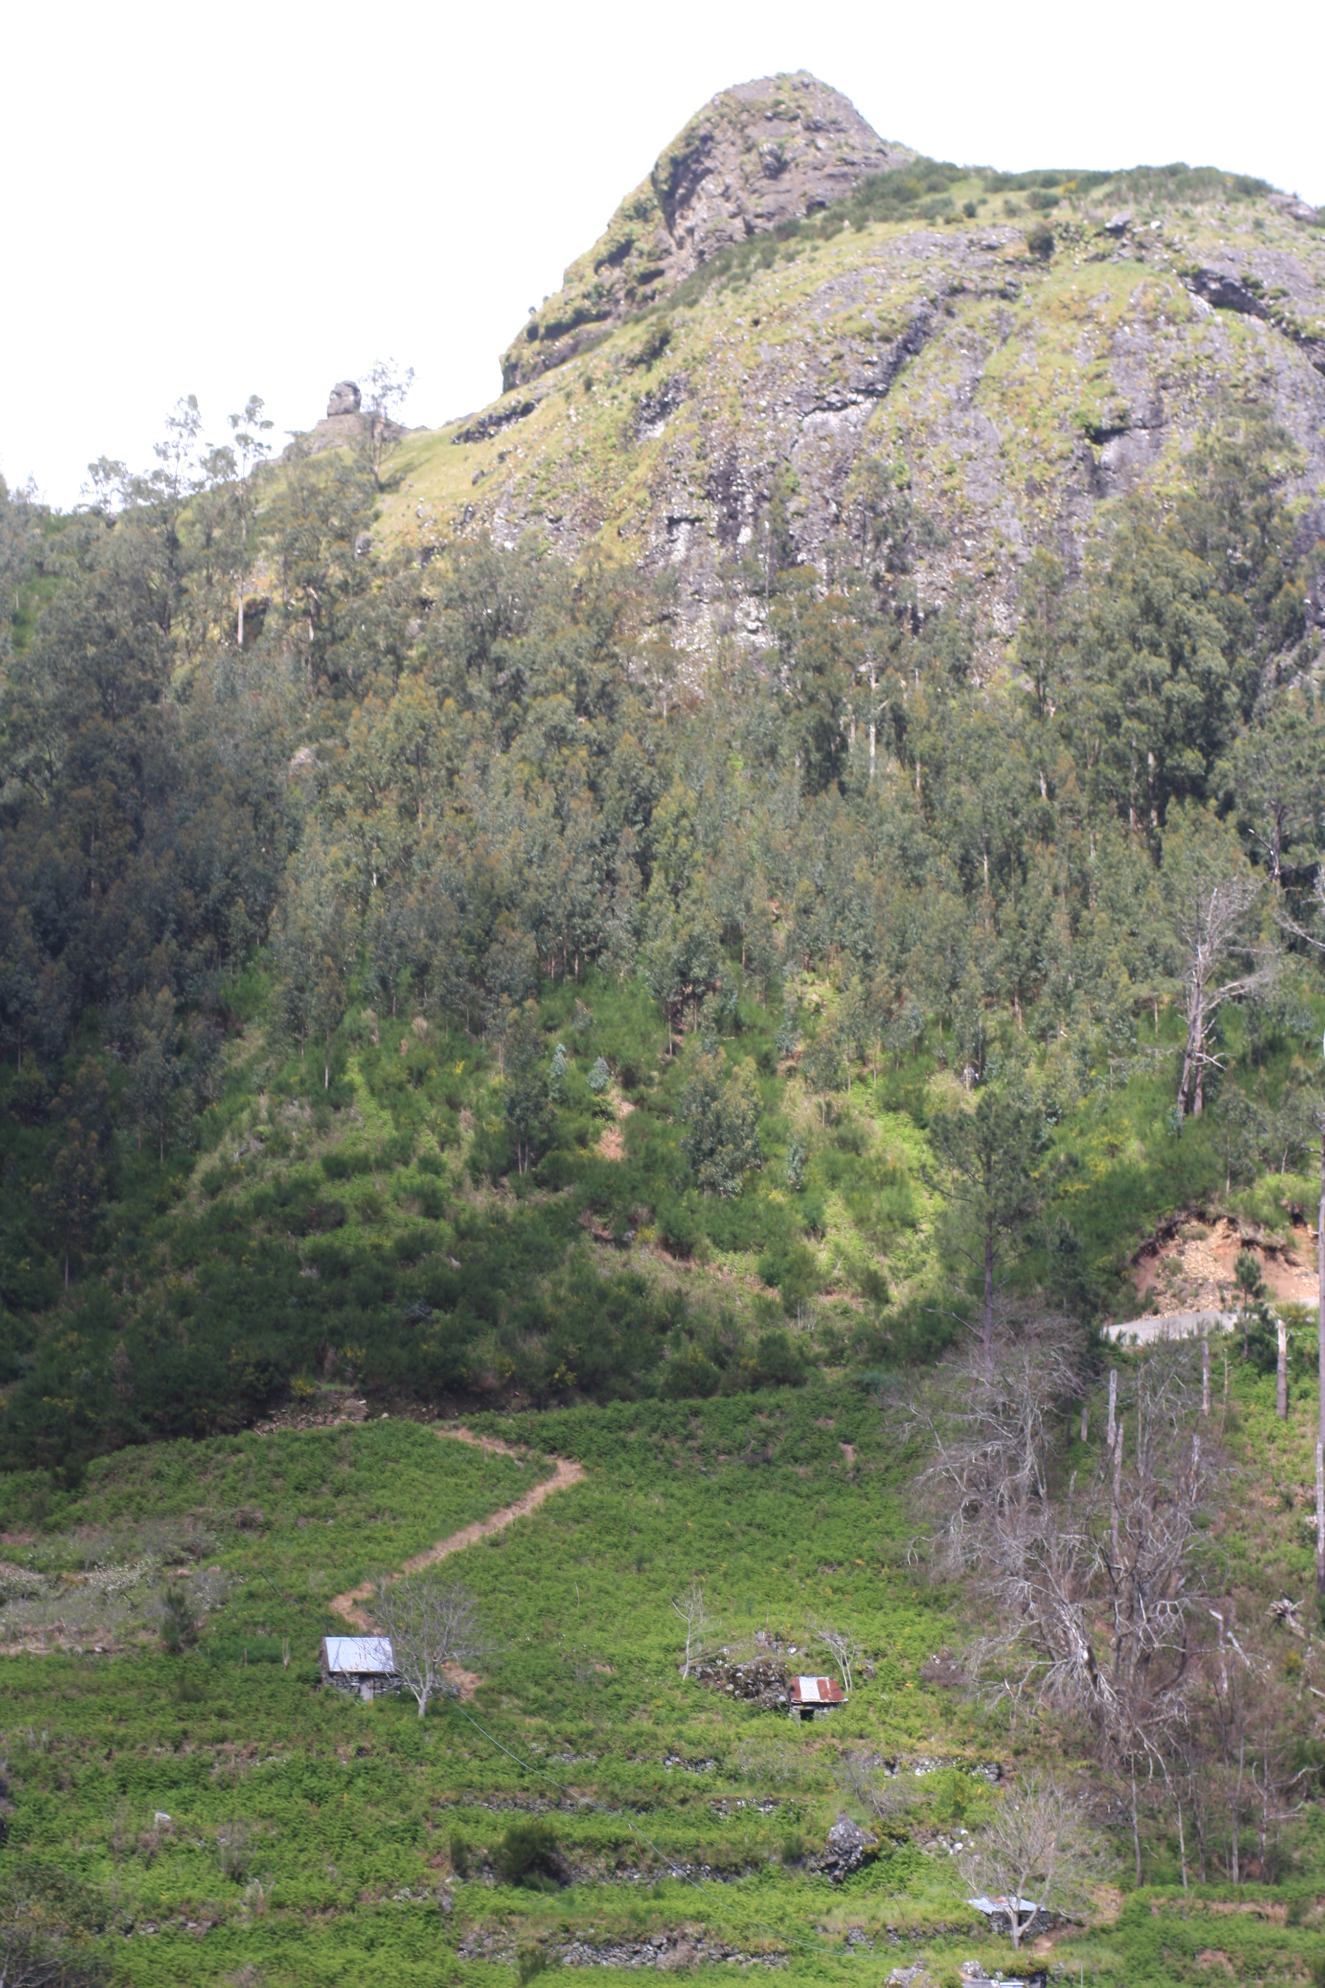
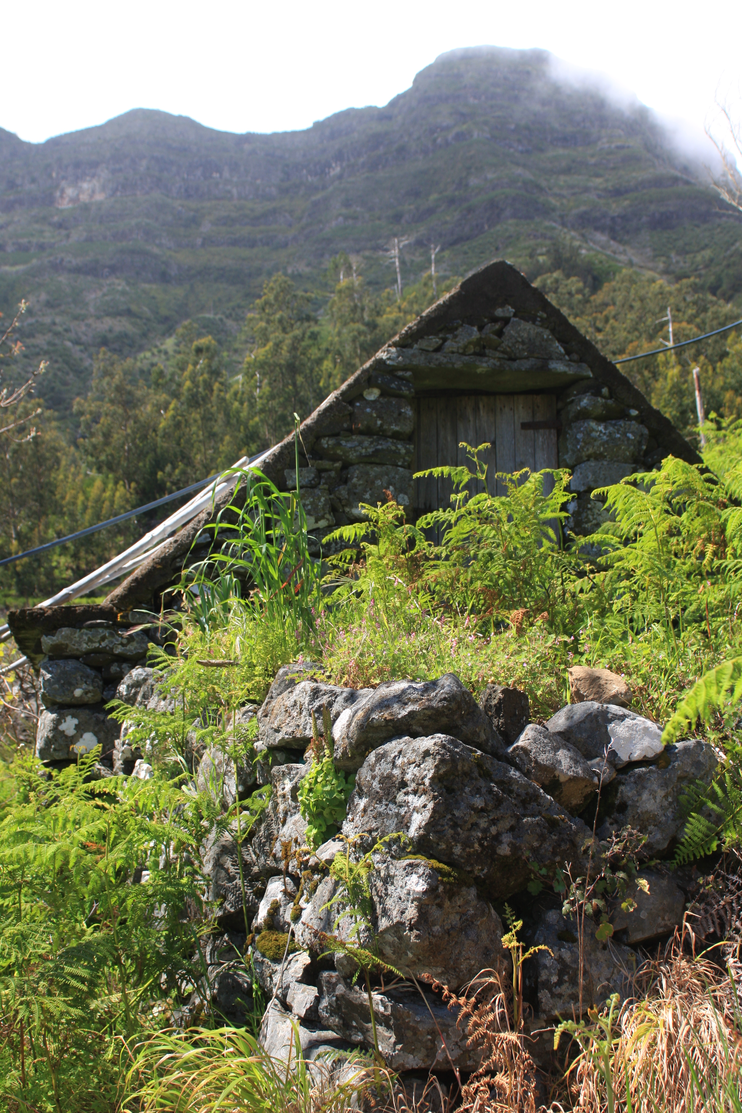
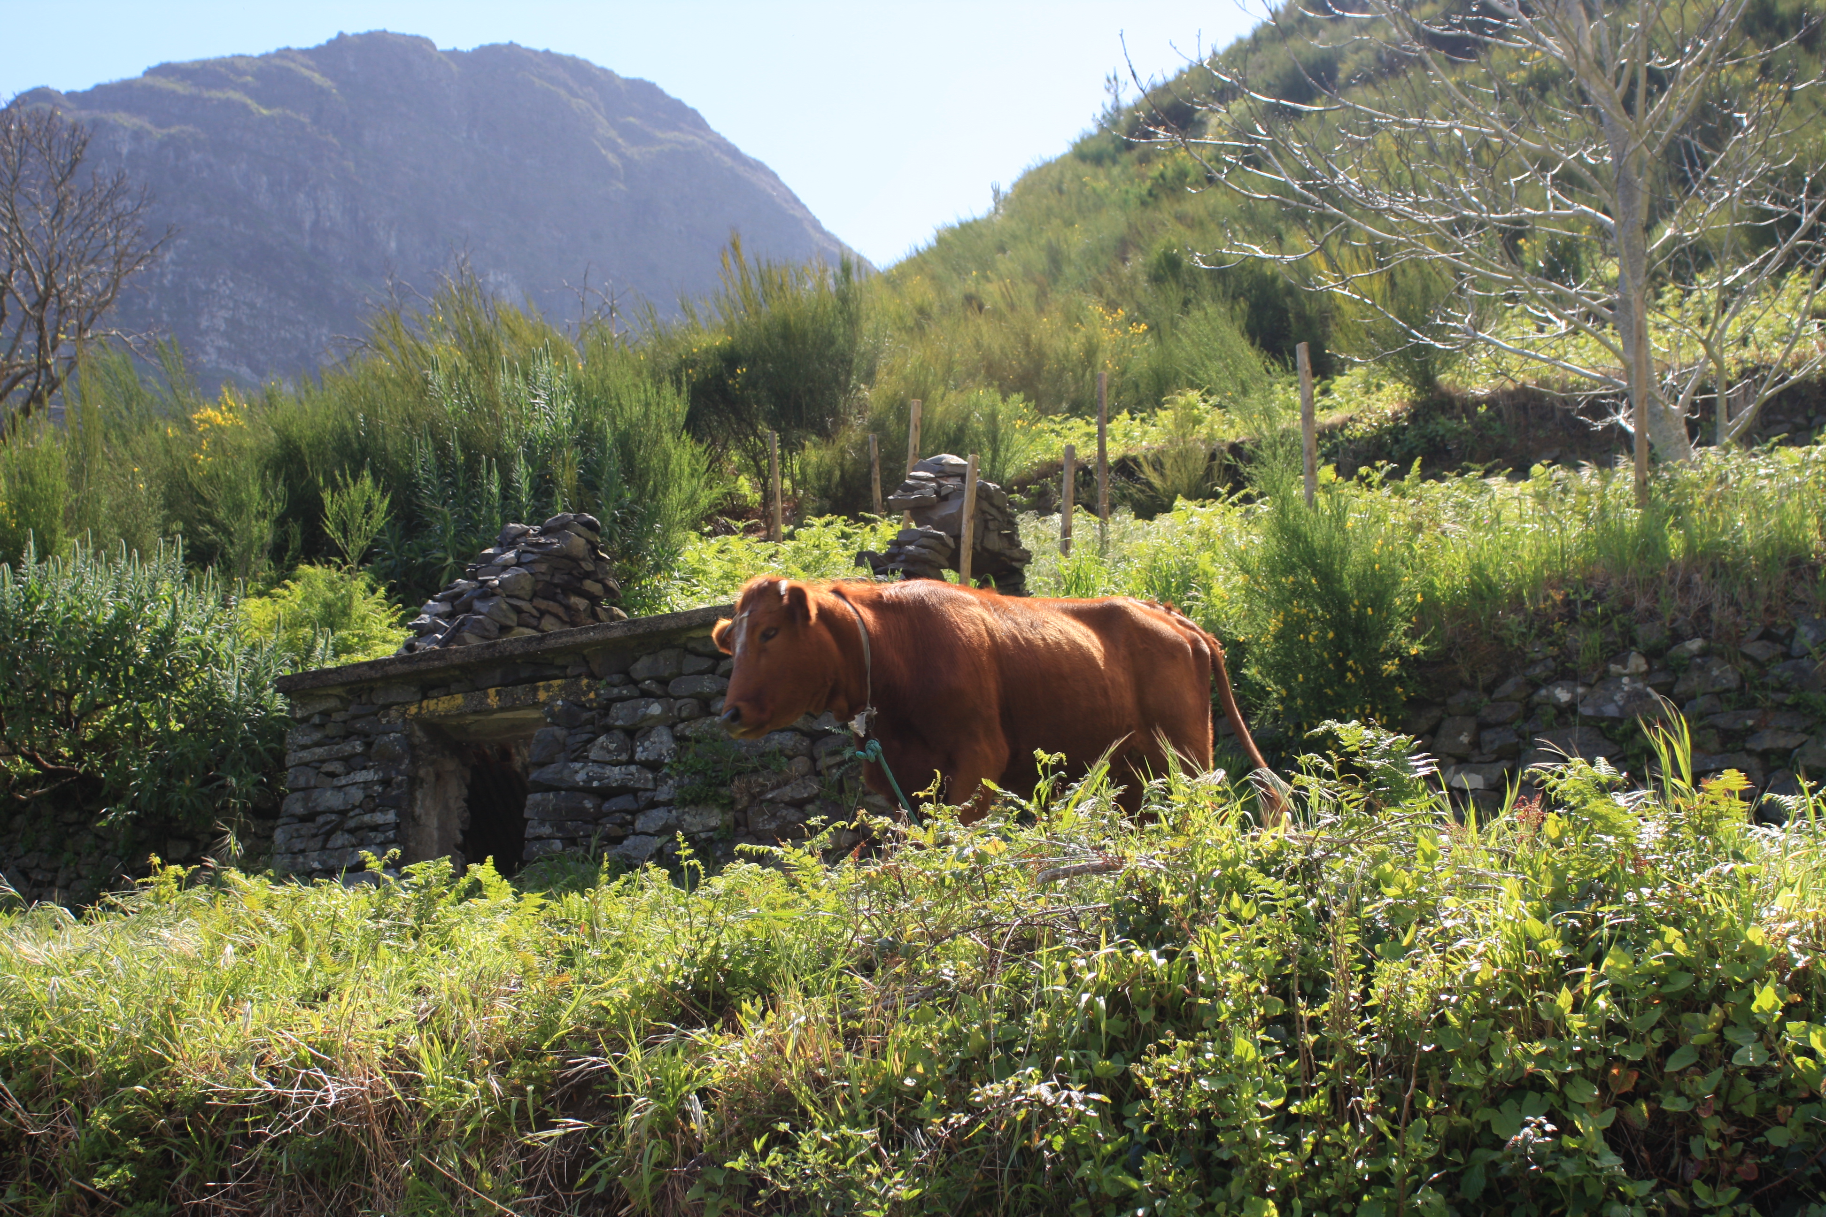
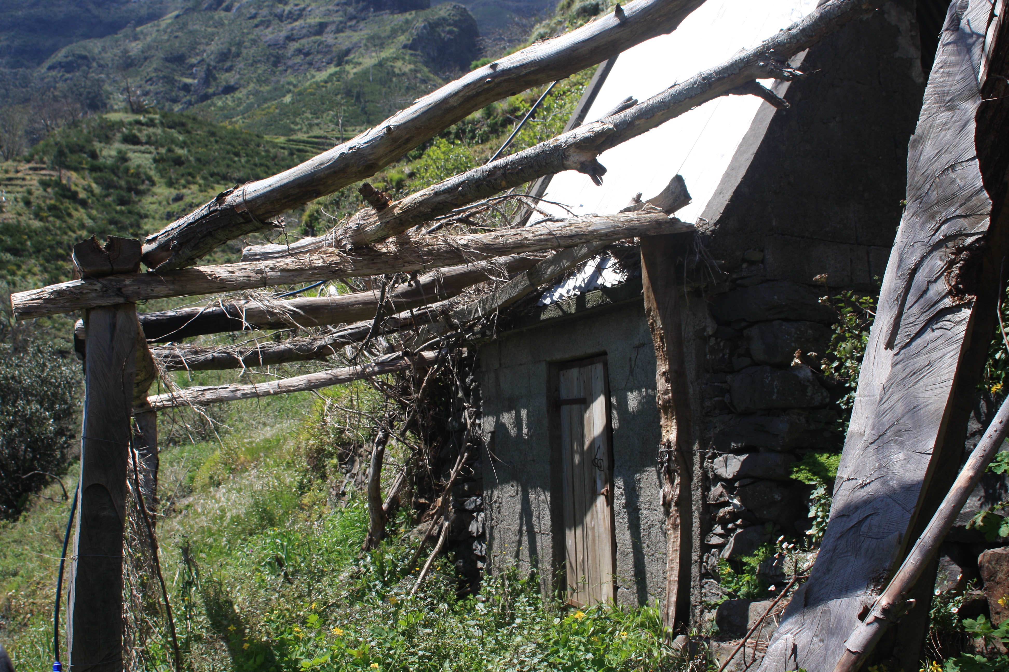

Slide 15
Drone movie from the Valley
https://www.youtube.com/watch?v=h9A4p2V4D4E

Slide 16
AldeiA Team
CHRISTIAN ROLAND - FOUNDER
aldeia@yahoo.com
* From Kristiansand, Norway
Living Part time Oslo/ Serra de Água- Madeira
GRADUATION / SKILLS /AREAS OF INTEREST
* 2oo6-Graduation Vernepleier ( nurse/social work.
* Study 2 semesters of sports and pedagogic in central America, later multicultural.
* Communication in Oslo.
* Earned my first income as strawberry and apple picking.
* Rolands Relations (established my independent Healthcare Company 2015)
* In 2010 I moved to Oslo to live my passion of playing in different rock bands.
* My interests are trips in nature and sea, learning more about processes of ecosystems and self-development.
* I see opportunities, I’m creative and get easily in contact with people.

Slide 17
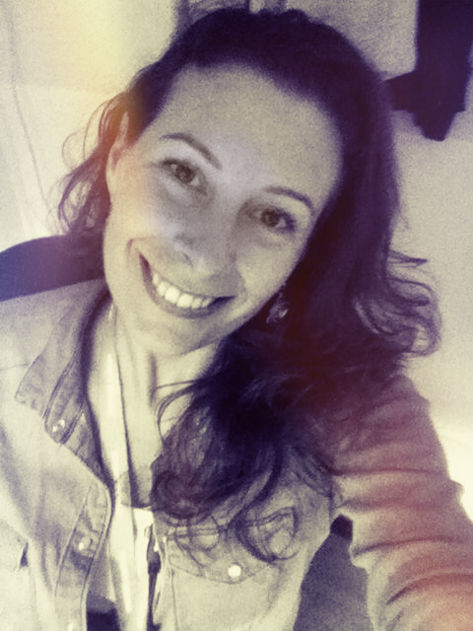
AldeiA Team
SUSANA GIL DA COSTA - COORDINATOR
susanasub@gmail.com
* From Porto, Portugal
Lived in Porto, Azores Island, Vila Real, Madeira Island
GRADUATION / SKILLS /AREAS OF INTEREST
* 2000-Graduation in Zootechnical Engineering (UTAD University – Portugal)
* 2012-CAP (Training Cours)
* 2003-HACCP(Hazard Analysis and Critical Control Point Cours)
* Amnesty International, Group Coordinator
* Swimming Instructor
* Sales Management
* Coaching
* Team leader
* Languages: Portuguese, Spanish, French, English
* 2001-Diving Cours (CMAS 2 star)
* 1995-Swimming and Waterpolo federated
* QiGong ,Tai Chi
* Microbiotics
* Traveled by 25 countries in 5 continentes
* Animal and environment preservation
* Ecotourism

